Slide 1





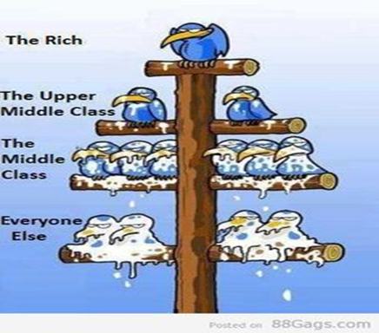
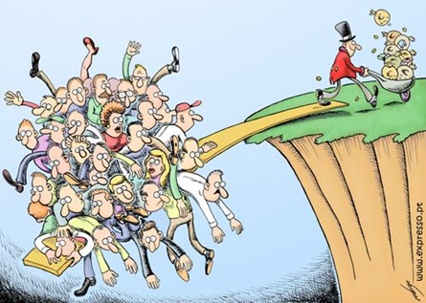

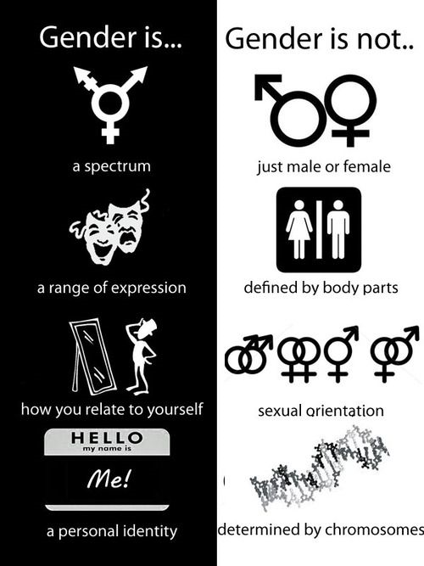
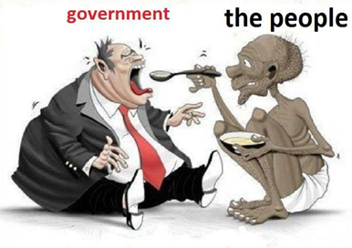

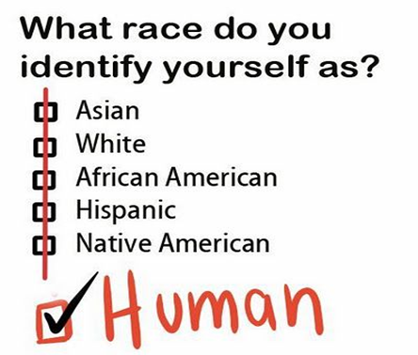
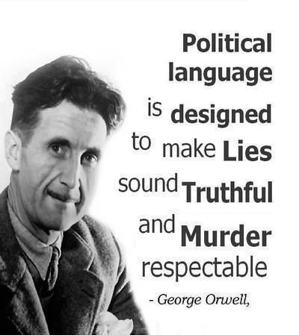

Challenge Work
Welcome Sociologists!
We are looking forward to you joining us in September.
Please find a series of tasks in this booklet, these are designed to prepare you for A Level studies.
Enjoy! ☺
We follow the OCR A-level specification
If you have any questions over the summer email
jcolebrook@st-albans.Suffolk.sch.uk

Slide 2




Sociology is…
The study of society, large groups of people and individuals.
It studies how and why people behave the way they do in society
Looks at how structures such as family and Government influence human behaviour
A social science which uses research to investigate and predict human behaviour to help governments improve the lives of its citizens
A critical and radical subject, it is about questioning why society is as it is. It is about digging under the surface, looking at what is really going on.
Is sociology for me?
Yes, if you’re interested in questions like these…
Why are some people rich and some people poor?
Are children and young people treated unfairly in society?
Are people successful because of their background or how hard they work?
Why are some of the hardest jobs poorly paid?
Why are a large proportion of MPs white, male and from private schools?
Would the world be happier if there was just one religion?
Sociology is NOT...
An easy subject
Just common sense
Wishy-washy and unscientific
Psychology

Slide 3

What kind of Sociologist will you be?
1. The defining characteristic of human behaviour is:
A) Their gender/ sex
B) Their social class
C)Their Race
D) Their integration into society
E) Their culture
2. We have the freedom to choose our own behaviour
A) Yes
B) No
C) Depends
D) Doesn’t matter
E) What is freedom?
3. What are your views on the family….
A) Family is oppressive to women and teaches us to conform to gender roles
B) Family is a tool of the ruling class teaching us to obey authority
C) Family is a vital part of socialisation that teaches us norms and values
D) Family is what you make it, everyone has a different view on it
E) Family – what is a family? You can’t define it
4. When it comes to inequality
Gender is the most serious issue!
Money and power the rich exploit the poor!
Inequality is normal part of society
Inequality is a label that has different meanings to people
You make your own reality up
5. When it comes to Crime
The justice system is more lenient on women
Criminal laws protect the rich and powerful
Crime is good for society as it reminds us of the rules
Crimes are actions labelled as wrong to influence our behaviour
Crime – what is a crime? Can we really define what a crime is?
6. When it comes to religion
Religion oppresses and controls women – telling us to cover up and be obedient
Religion is a tool used by those with power to control us
Religion is a useful institution which unites people who share a common set of beliefs
Religion means different things to different people
Religion is just another meta-narrative (big story) people use to explain reality

Slide 4
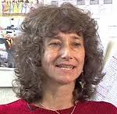
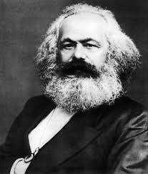
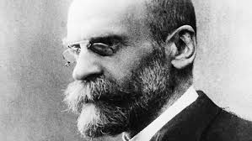

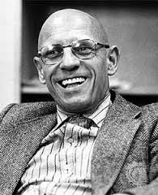
What kind of Sociologist will you be?
Mostly A – Our Feminist
You are most likely to turn into our Feminist Sue Sharpe. Feminism looks at how society is structured in a way that benefits men while oppressing women – this is known as patriarchy (male domination.). The theory is often a misunderstood as stereotypes and misconceptions about it exists. Many people do not realise that there are several types of feminism such as black, radical feminism and liberal.
Mostly B – Our Marxist
You are most likely to turn into Karl Marx. Marxism looks at how society is constructed is a way that produces class conflict with the rich having all the power and control whilst the poor are oppressed. Marx argues that the root cause of class inequality is down to capitalism as it encourages people to be greedy and materialistic. Just as capitalism replaced feudalism, Marx argues that capitalism will one day be replaced with communism
Mostly C- Our Functionalist
You are most likely to turn into Emile Durkheim. Functionalism is theory which argues that members of society are united together by a shared set of idea and beliefs called ‘norms’ (normal behaviour.) These norms are accepted by all members in society and are enforced by structures such as family and education. They see society like a human body – with all parts needed in order for it to ‘function’ and work effectively.
Mostly D- Our interactionist
You are most likely to turn into Becker/ Mead. Interactionism looks at how people create meaning during social interactions, how they present and construct the self (or identity) as well as how they define situations. One of the perspectives key ideas is that people act the way they do because of how they define situations. Becker uses the example of nudity to illustrate how timing, place and audience can influence how people see an action or idea.
Mostly E – Our post-modernist
You are most likely to turn into Foucault. Post-modernism is a more recent Sociological theory which seeks to question and de-construct existing structures and understandings of reality. Post modernism rejects the idea that one theory such as functionalism, Utilitarianism, religion or even science can explain reality!

Slide 5
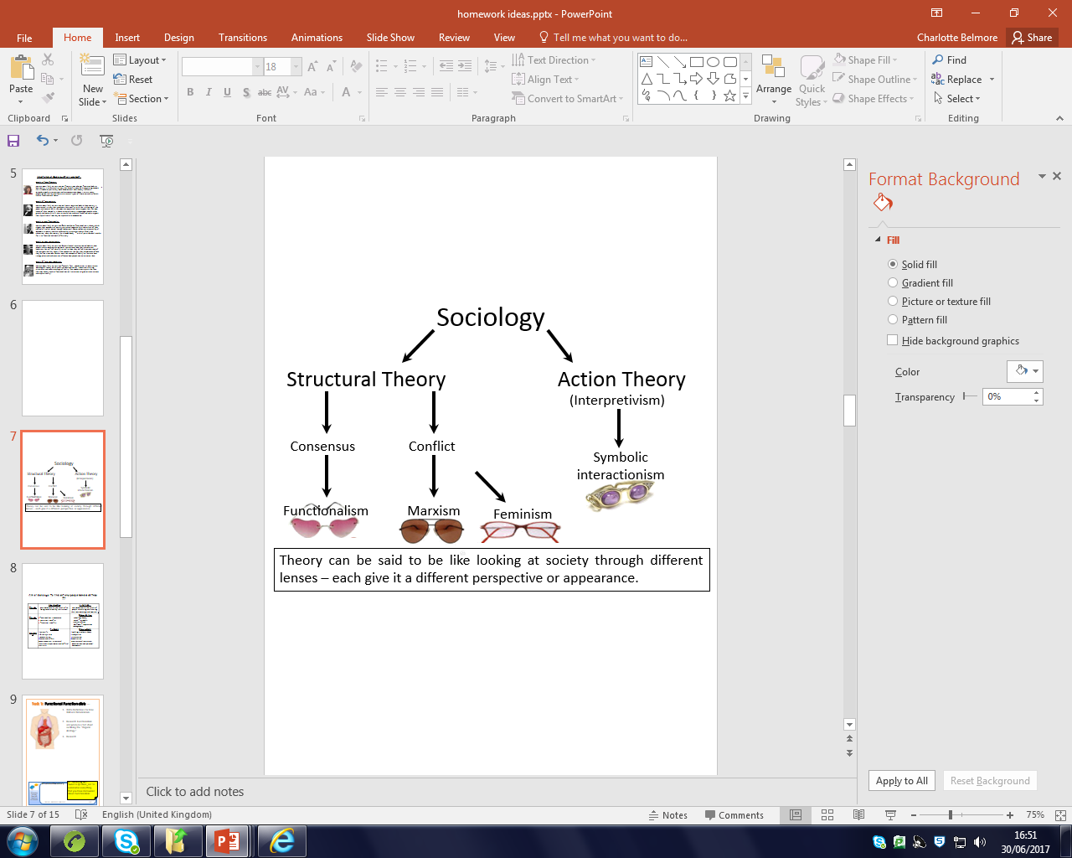
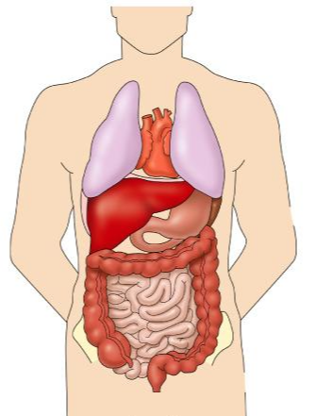
Theory is a big part of Sociology!
Task 1: Functional Functionalists…
Write Definitions for Free Will and Determinism.
Research Functionalism and produce a fact sheet outlining the “Organic Analogy
Do some further research on Functionalism
Write a paragraph on the strengths on the theory
Write another on the weaknesses of the theory

Slide 6
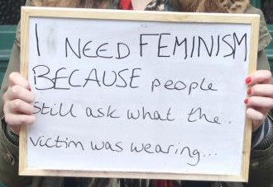
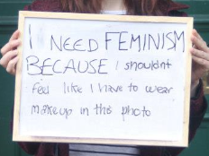
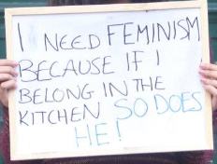
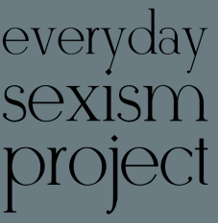
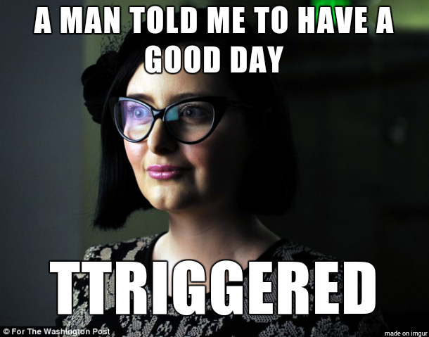
Task 2: Fiery Feminists…
Watch youtubclip: https://www.youtube.com/watch?v=mtfsfsBNgiw Write down your thoughts and feelings after watching the clip. What did you find interesting? Shocking? 2. Research Feminism and produce a fact sheet outlining the definitions and provide examples. 3. Research @ or #EverydaySexism What is the project? What examples do they give of modern sexism? Do you think sexism is still a problem today? Why? Do ALL women have the experience? Explain you answer? Explain!
Research examples of gender inequality within the UK in contemporary society.

Slide 7
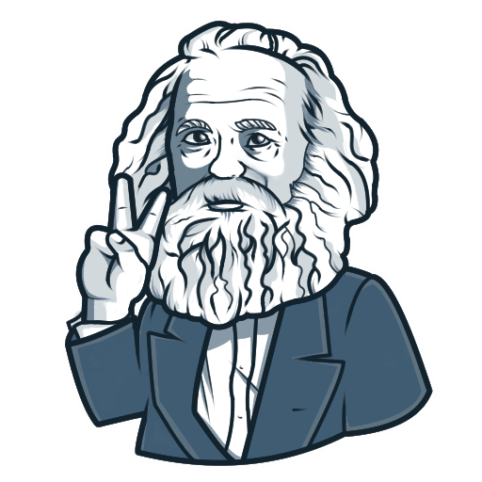
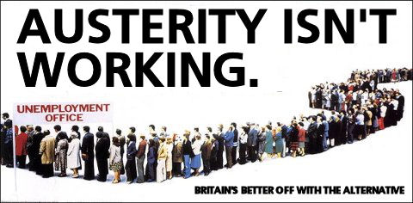
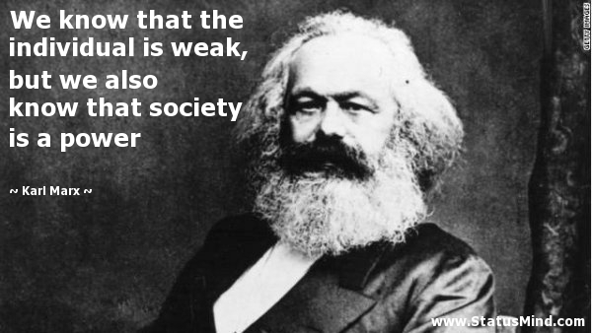
Task 3: Magnificent Marxists…
Watch YouTube clip
https://www.youtube.com/watch?v=gR3igiwaeyc
Define all key words on the video clip. Research Marxism and produce a fact sheet outlining the difference between the bourgeoisie and the proletariat. Research examples of class inequality within the UK in contemporary Society. Choose one of the examples and explain how a Marxist would interpret the situation How would a functionalist counter this approach?

Slide 8
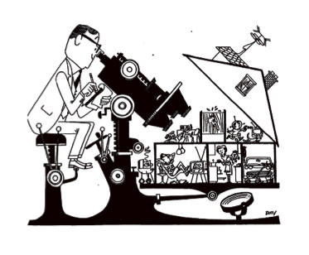
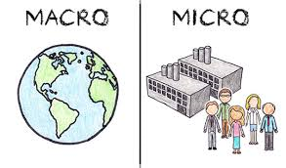
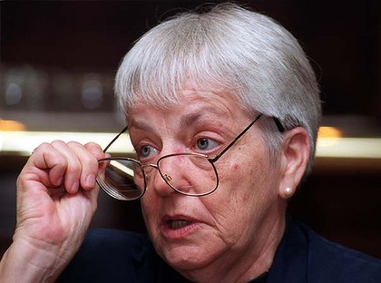
Task 4: Autonomous Social Action Theorist…
Functionalism | Feminism | Marxism
Complete a Summary table for your notes outlining each approach and stating whether they are:
Consensus or Conflict Theories
Macro or Micro Approaches
Structural or Social Action
Ensure that you define which words in bold go with which theory! Add the strengths and weaknesses of each to the table too!
Watch the following you tube video: https://www.youtube.com/watch?v=yJrnwOPC2f8 Define Social Action Theorist approach to society.
Do you think we have free will within society? What perspective would Social Action Theorist take on this question?
How would a structuralist respond to the idea of free will? Do you agree? Explain

Slide 9


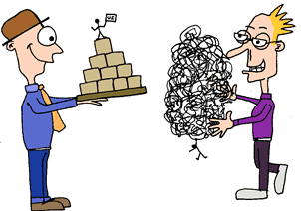
Task 5: Passionate Post-modernists…
Watch the following YouTube video:
https://www.youtube.com/watch?v=QqsP0vQJJ44
Produce a factsheet outlining what post-modernism is and what it says about society
Produce a table outlining the differences between a modern and post-modern society. (you may need to do more research!)
Find examples of post-modern changes in society within the Media. For example Same Sex Marriages in the USA.
4. Out of the 5 theories you have researched - Which Sociological theory do you most and least agree with and why? Explain your reasons in detail making sure you explain what it was about that particular theory (at least a side of A4)!
Modern | Post-Modern

Slide 10

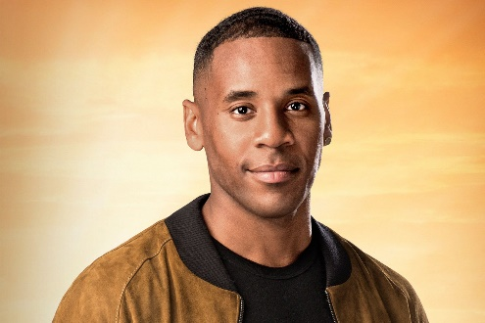

There are a lot of key terms that you need to know for your exams and to make sure you write great essays! Lets start off with the basics:
Task 6: define the following sociological key terms:
1. Norms
2. Values
3. Socialisation
4. Society
5. Culture
6. Identity
Now for each of the key terms add a picture and an example to go with them
7. Social differentiation
8. Stratification
9. Status
10. Subculture
11.Cultural diversity
12. Consensus
13. Conflict
Task 7:
Outline and explain the way government policies of social isolation/lockdown during this Coronavirus pandemic might have an impact on each of the following:
The way in which domestic chores are shared
The experience of childhood
The structure of families and their households
Domestic violence
Education
The impact on capitalism
Social class inequality
Task 8: watch some TV!
Sociology is everywhere, so you’ll be able to see aspects of it in all forms of media. Try searching for the following titles and make notes on any videos you watch, try to keep it relevant to the topics taught in Sociology (see above).
School Swap documentary (BBC iPlayer/YouTube)
Stacey Dooley documentaries (BBC iPlayer/YouTube)
Seaspiracy (Netflix)
Time (BBC iPlayer)
The Social Dilemma (Netflix)
13th (Netflix)
Black Mirror (Netflix)
Reggie Yates documentaries
Dispatches documentaries (4OD)
Panorama documentaries (BBC iPlayer)

Slide 11
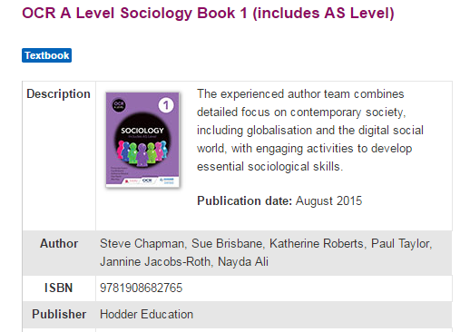
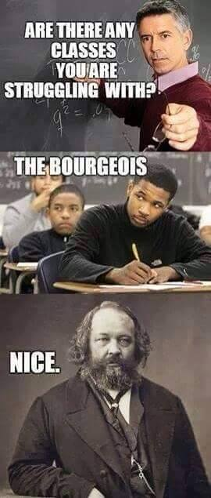
Useful Resources & Further Reading
To help you on your way…
It is also recommended that you take an active interest in the news and what is going on around you in the wider world as a lot of the concepts and ideas covered in lessons will relate to what is going on. The ability to be able to draw upon contemporary examples will also help illustrate your application and understanding skills which will be vital in order for you to achieve the higher grades in this subject.
You will be expected to purchase a text book in both the first and second year, you will only need to purchase Book 1 for Year 12 (see below).
You may order this yourself (it is available on Amazon/Hodder Education), or you could order through the school when you return in September.
Any questions please feel free to contact me over the summer period via email – jguy@st-albans.suffolk.sch.uk
Have a great summer holiday and come back refreshed! Look forward to seeing you all in September ☺

