Slide 1
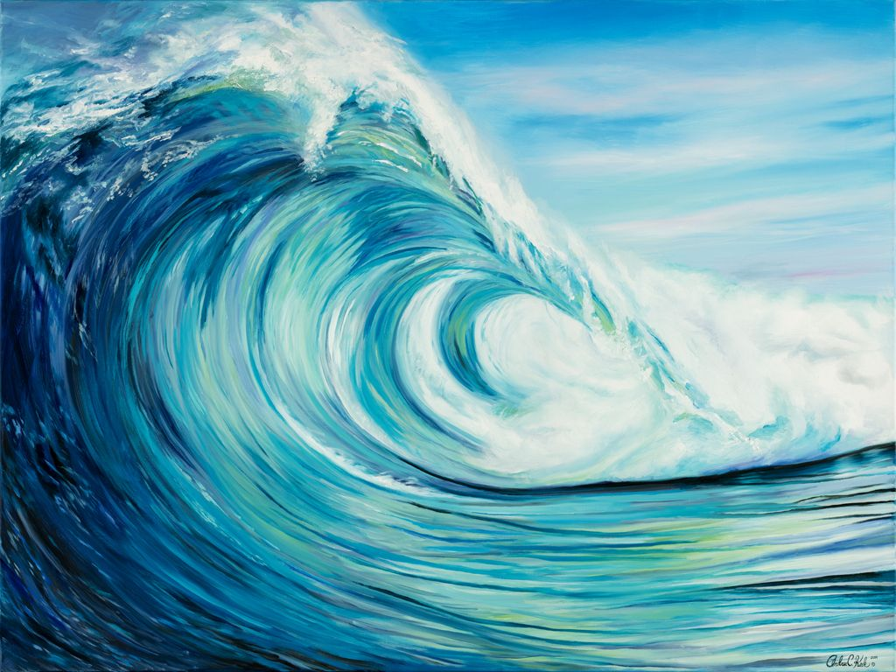
Year 11 ART
Summer transition task

Slide 2

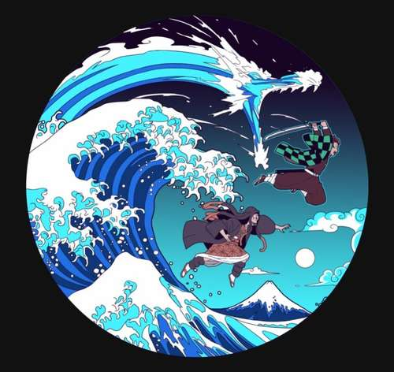
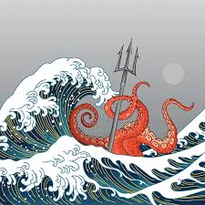
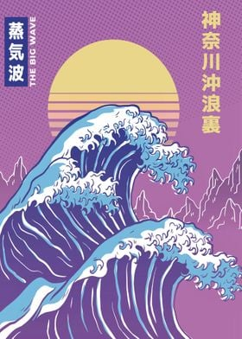
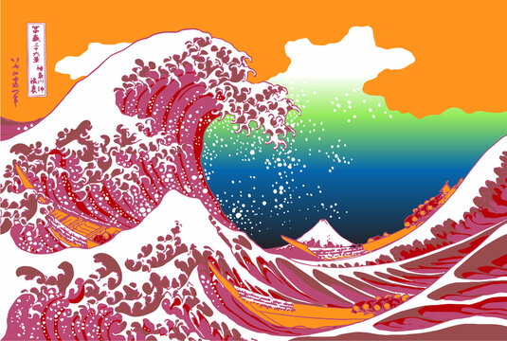
What do all of these have in common??

Slide 3
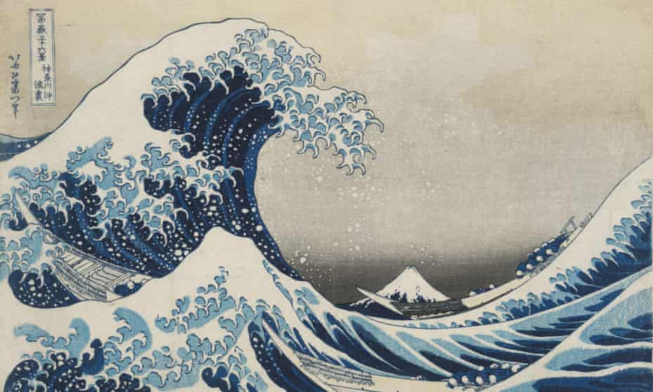
Yes! All variations on Hokusai’s Great Wave off Kanegawa
If you had creative freedom to respond to this, or any artist’s work just what would you create??

Slide 4
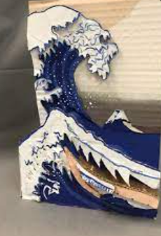
Year 11 ART
Summer transition task
Select an artist that inspires you. Produce a study page based on an artist of your own choice- include information, images and a reasoning behind your choice.
Plan and create a response to your chosen artist (focus on a single image) but in an alternative technique. Suggestions are:
Painter…….. Create a response in mixed media or 3d?
Sculptor……. Create a digital painting or spray can art as a response ?
Bring your research page and outcome to your first lesson in September. Consider how you will explain your choice, process and outcome.
Ideas and suggestions on the next slides

Slide 5
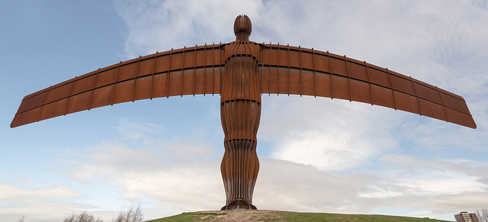
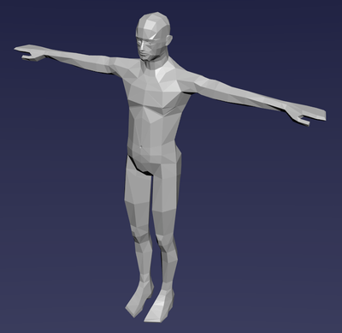
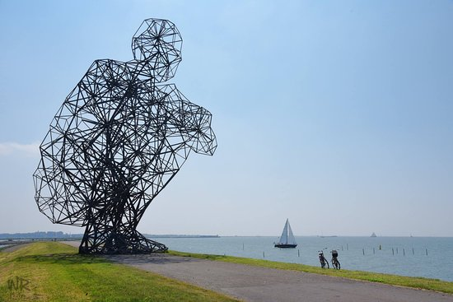
Perhaps create human forms using Blender as a response to Antony Gormley’s work?

Slide 6
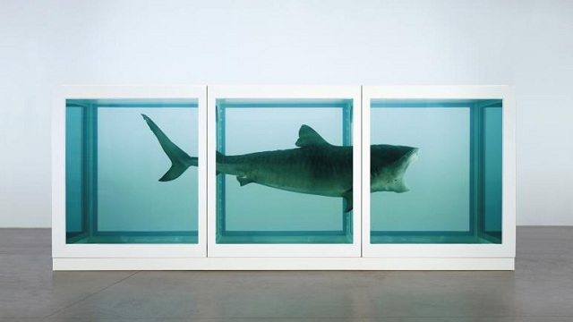
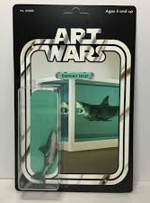
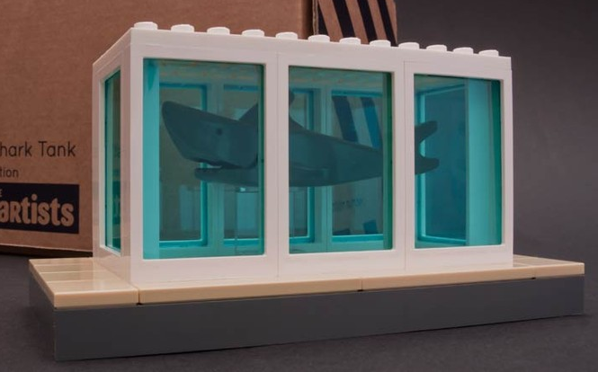
How would you respond to Damien Hirst’s ‘shark in formaldehyde?’

Slide 7
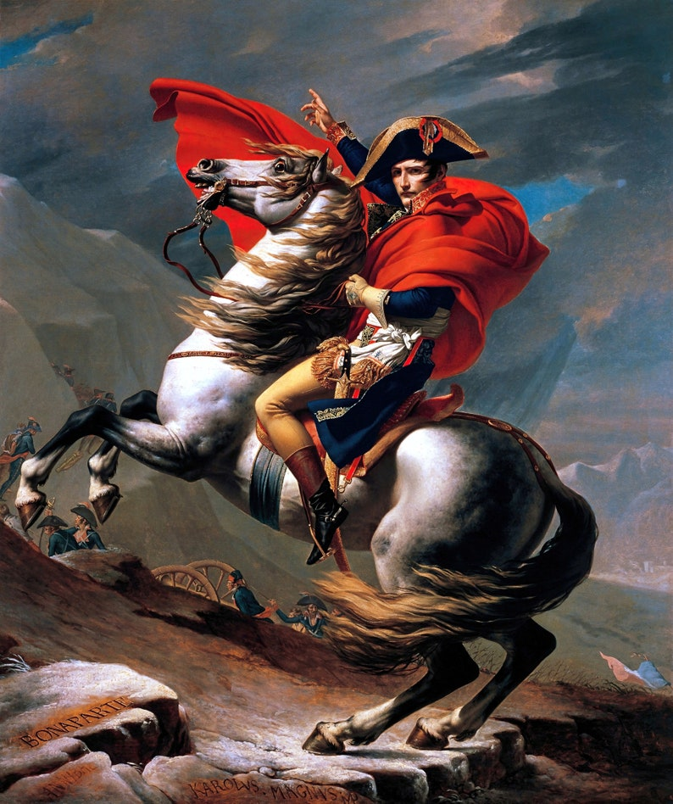
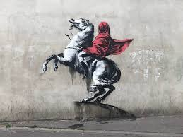
For example, Banksy recreated this famous painting of Napoleon by Jaques Louis David…
How would you reinterpret this image?

